Slide 1

ZRCS – MPharma Pharmacy Management Project
Dakar IFRC Partners Meeting - January 23rd, 2018
Andrea Manongwa – Project Coordinator
Mac Krzyzewski – Global Operations Lead

Slide 2
Why are we Here
Partnering together to build a network of pharmacies that provide low cost, high quality medicines in a sustainable, revenue generating manner
Notes:
Mac

Slide 3
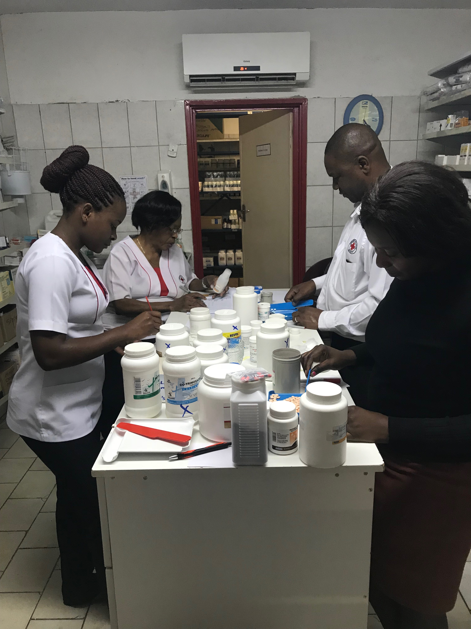
Presentation Overview
Who is mPharma?
What does our partnership look like?
How do we implement this?
Why makes this unique?
Notes:
Mac

Slide 4
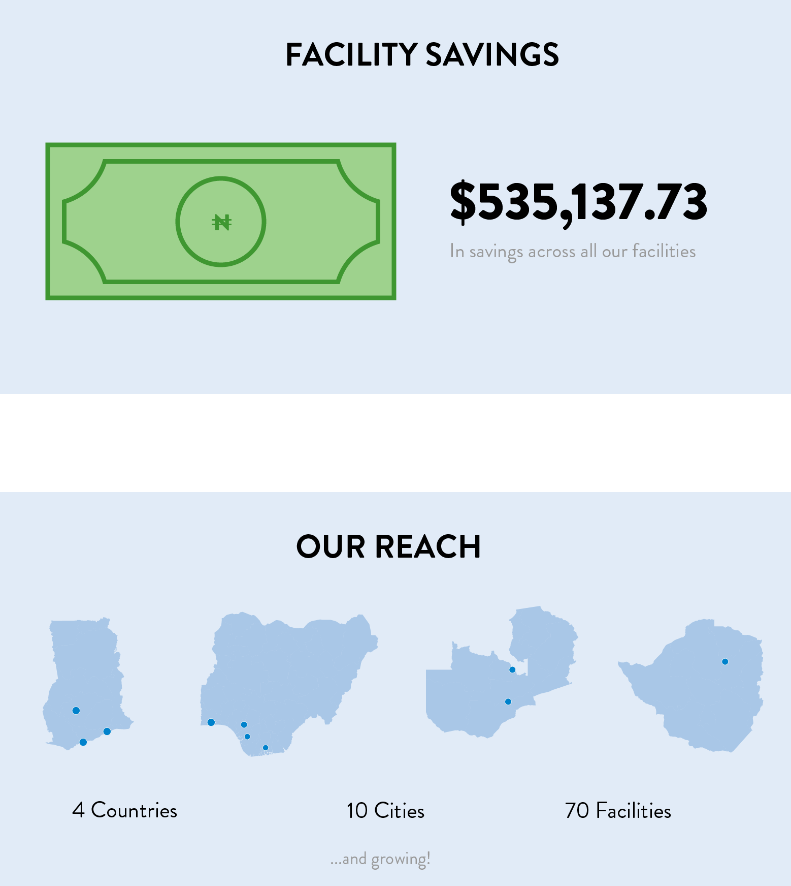
Who is mPharma?
Prescription drug benefits manager for providers and payers in Africa
Notes:
Mac

Slide 5
Who is mpharma?
Notes:
Mac

Slide 6
Video

Slide 7
What does our partnership look like?
Shared Values
Make medicines accessible and affordable for every Zimbabwean
Complementary Strengths
ZRCS provides market expertise, consumer trust and brand recognition
mPharma provides lower priced medicines, financing and Pharmacy Benefit Manager technical expertise
Joint Mission
Sustainable network of low-cost, high-quality clinics and pharmacies
Supports Area of Focus 4: Develop at least two shared value partnerships to bring non-traditional donors to NS health-related services.
Notes:
Mac

Slide 8
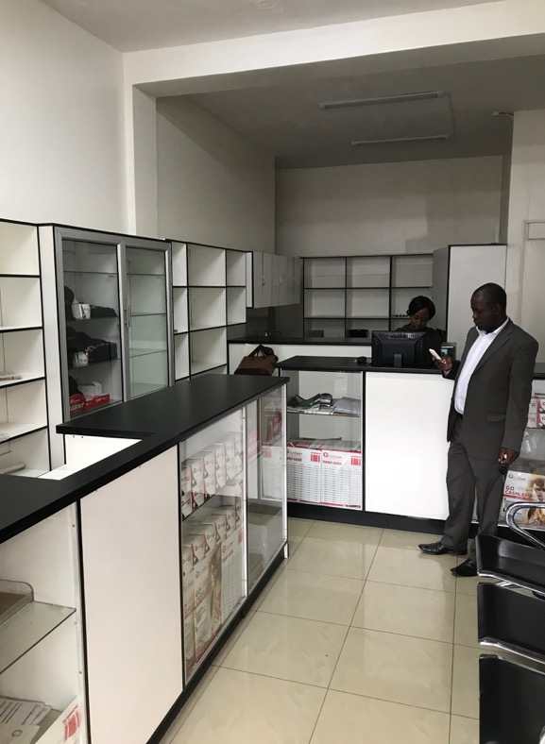
How Does it work? (Phase 1)
Proof of Concept: Mid-2017 to Early 2018
Mid ‘17: Introductory meetings and feasibility assessment
Sept ‘17: Partnership agreement signed
Nov ‘17: mPharma team on ground
Jan ’18: First order delivered to existing pharmacy in CBD healthcare facility
Mar 2018: CBD pharmacy moved into new, larger, street-side location downstairs from the healthcare facility
Notes:
Andrea

Slide 9
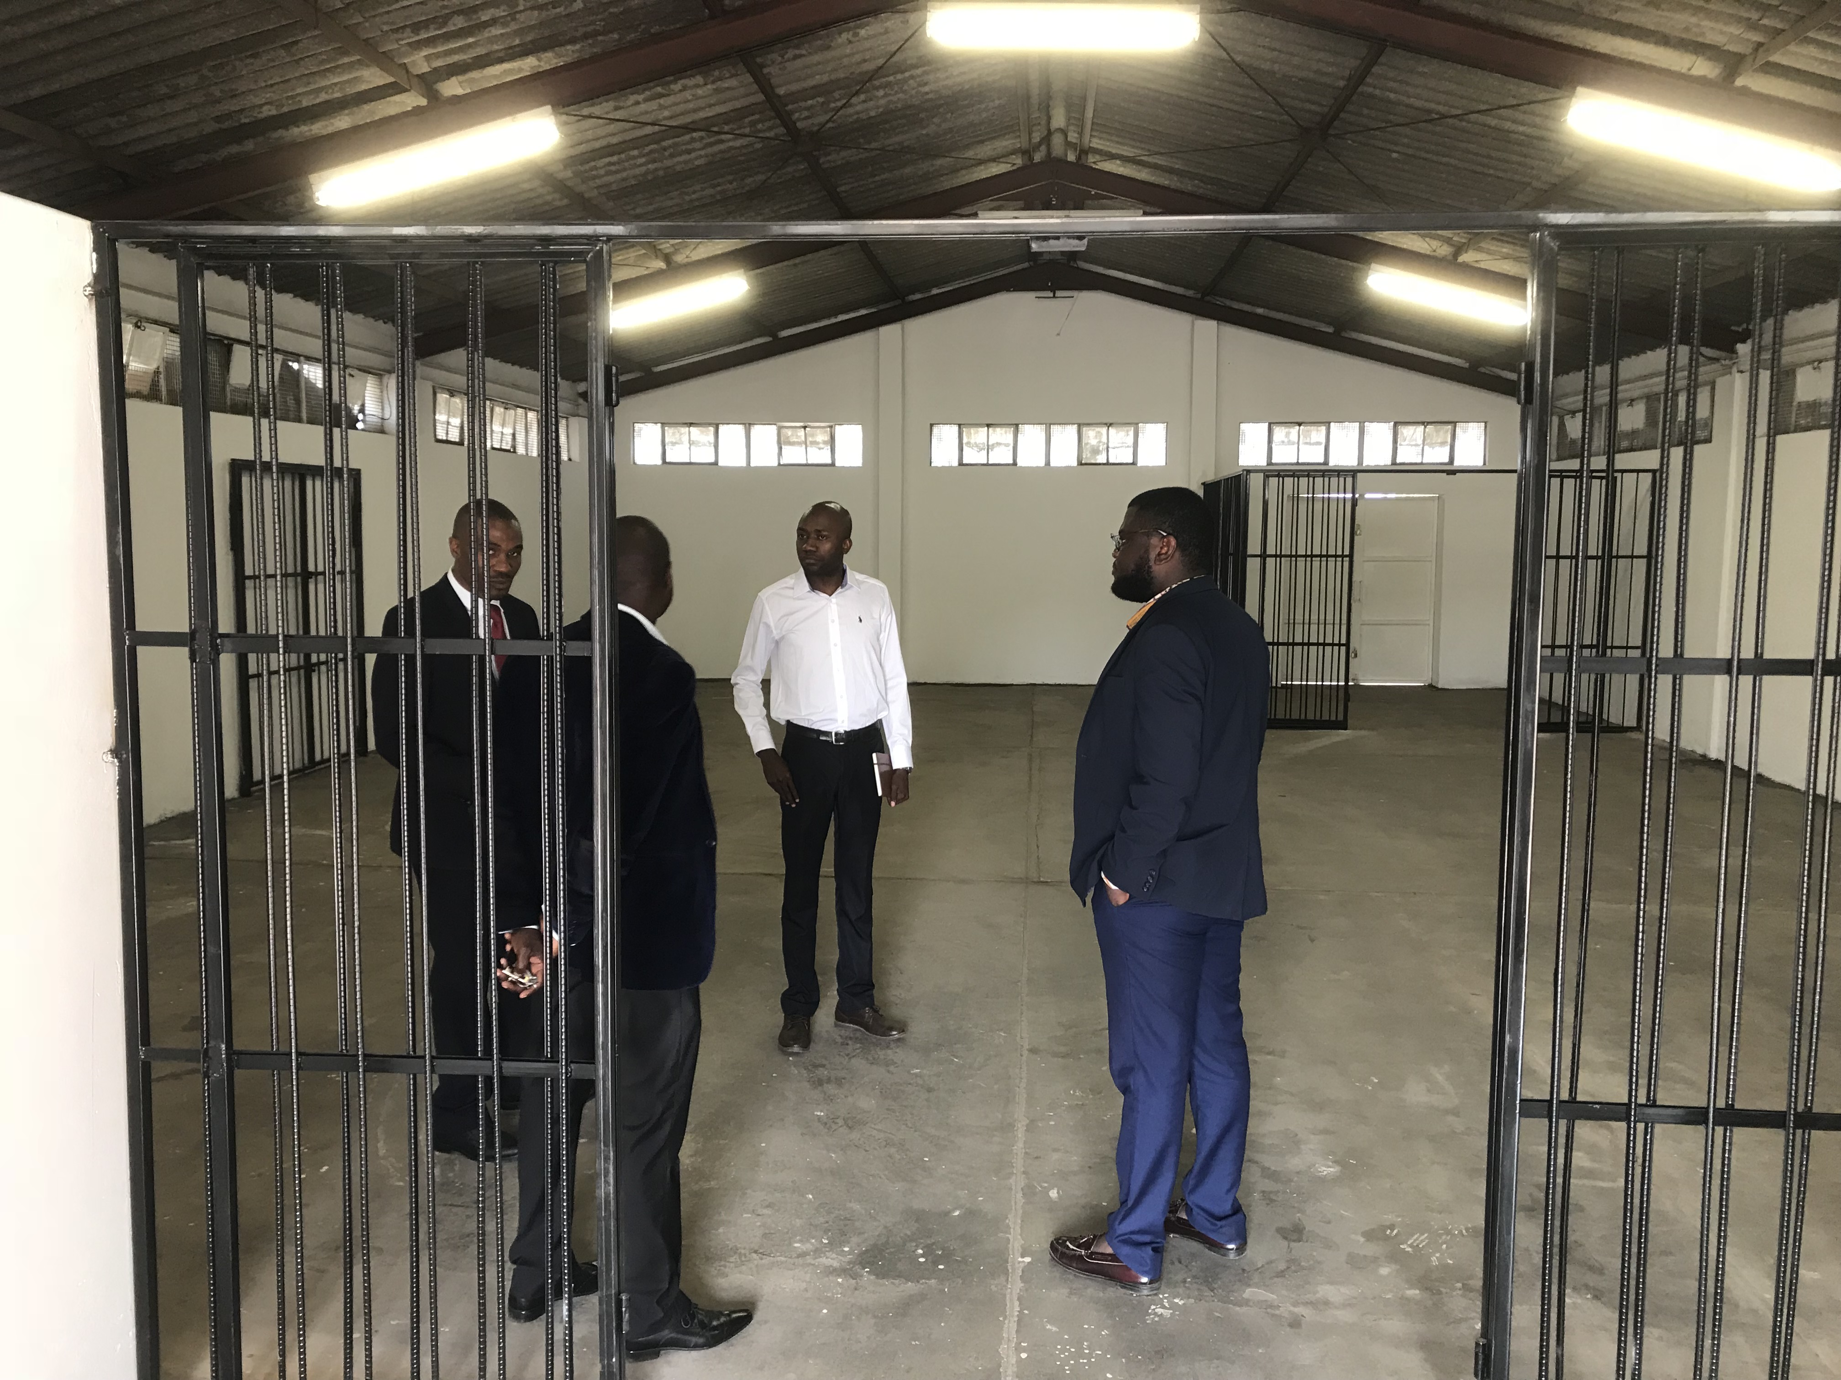
How Does it work? (Phase 2)
Network Expansion: Mid-2018 to 2019
Renovate existing ZRCS properties into small primary healthcare facilities or retail pharmacies in urban and peri-urban areas
Goal is to have chain of local pharmacies across the country
Warehouse Expansion: Late 2018
Begin procuring directly from multinational manufacturers and distributors
Act as a low-cost distributor for other healthcare facilities serving urban and rural populations
Additional source of revenue
Notes:
Andrea

Slide 10


How Does it Work?
Day-to-day management of core pharmacy functions
Dispensing and billing
Customer service
Facility Accounting
Real estate management
Access to physical structures
Facility maintenance/oversight/security
Infrastructure Investments
Startup costs: renovations, fittings, licenses
Inventory management
Formulary Design and Financing
Procurement
Design & implementation of value added services
Pharmacy & Patient technology solutions
Patient financing schemes
Patient care management programs
Notes:
Andrea

Slide 11
Core Tenets of Our Pharmacies
Affordable
Reliable
Innovative
Sustainable
Medicines at prices every Zimbabwean can afford
Medicines always well-stocked and available at the pharmacy
The latest technology will be utilized to offer personalized service for all customers
Pharmacies will be self-sustaining without needing donor funds or subsidies
Notes:
Mac

Slide 12
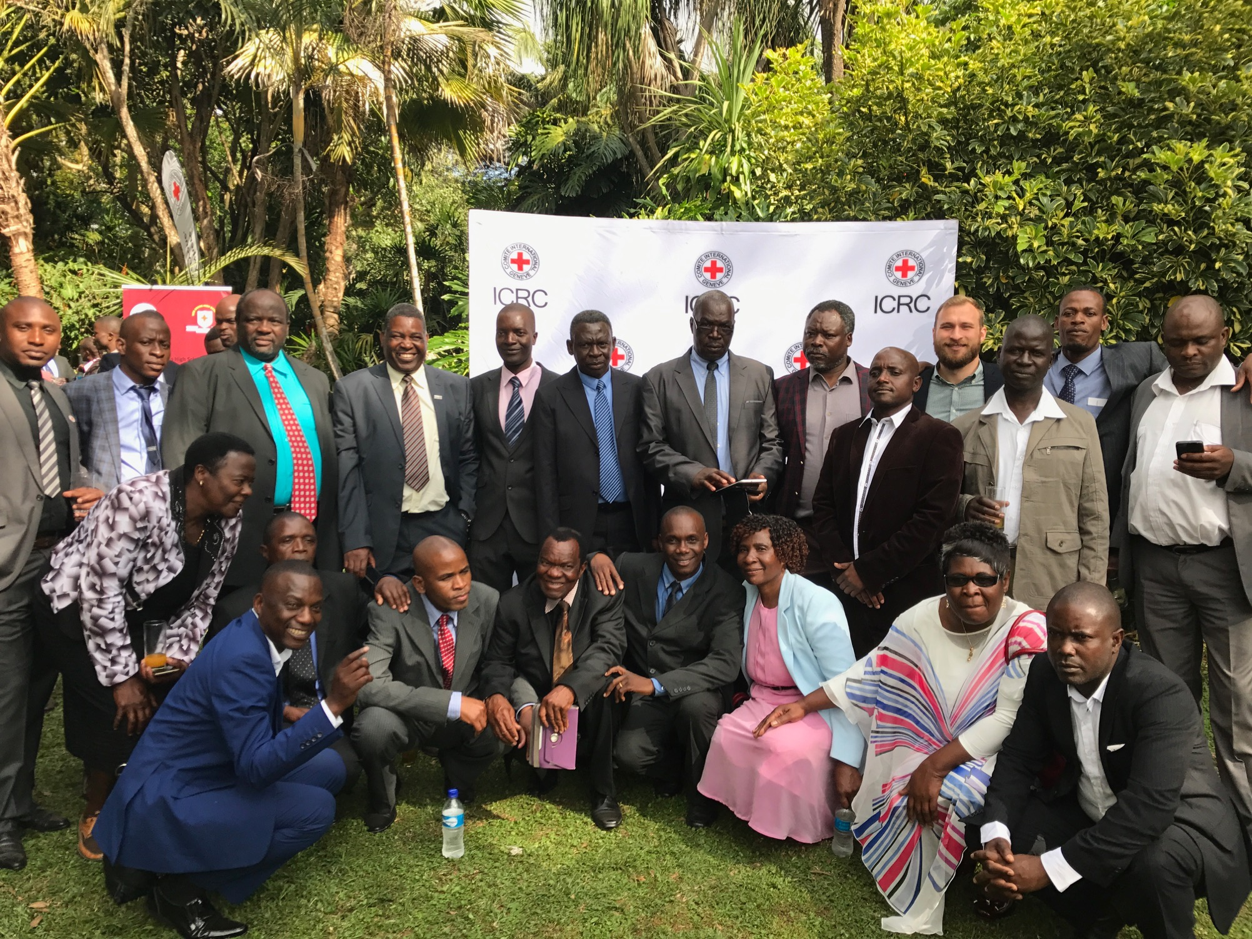
Thank you!

